Slide 1




Web Sites with XHTML and CSS
Slice and Dice: From PSD Image to XHTML+CSS
Svetlin Nakov
Telerik Corporation
www.telerik.com

Slide 2
Table of Contents
From Image to XHTML+CSS: Step by Step
Floating DIVs and DIVs Behaving Like Tables
Vertical Alignment of DIVs
Centering Site Contents
Web Site with Frames
Web Site with Tables
Web Site with DIVs
Slice and Dice: Showcases

Slide 3



From Image to XHTML+CSS
Creating Web Sites Step by Step

Slide 4
From Image to XHTML+CSS
Steps for converting a Web site image to XHTML + CSS ( + JavaScript )
Choose DOCTYPE
Decide on the layout type
Fixed width – what resolution (800, 1024, …)?
Fluid width – which parts will resize?
Identify site sections (determine the pieces)
Header, main, footer, columns, navigation, etc.
Decide on the layout model
DIVs vs. tables (any good reason to use tables?)

Slide 5
From Image to XHTML+CSS (2)
Steps for converting a Web site image to XHTML + CSS ( + JavaScript )
Distinguish between content and style
Text vs. images – which belongs to the content and which is part of the styling?
Create the page layout
Create the layout DIVs and define their CSS
Create the contents of each section
Test the site in different Web browsers

Slide 6
Choosing the DOCTYPE
Modern Web sites should use HTML5
Sometimes we want to support older Web browsers so we should choose between:
XHTML Strict (no presentational deprecated tags like <font>, <b> and <center>)
XHTML Transitional – includes the old tags
<!DOCTYPE html>
<!DOCTYPE html PUBLIC "-//W3C//DTD XHTML 1.0 Strict//EN" "http://www.w3.org/TR/xhtml1/DTD/xhtml1-strict.dtd">
<!DOCTYPE html PUBLIC "-//W3C//DTD XHTML 1.0 Transitional//EN" "http://www.w3.org/TR/xhtml1/DTD/xhtml1-transitional.dtd">

Slide 7
Fixed vs. Fluid Layout
Page layout can be fixed or fluid
Fixed width
Typical Web users use at least 1024 x 768 resolution → 900px-1000px page width is OK
Mobile devices have smaller screen
Fluid width
Ensure the main page content resizes correctly
Beware of very large screens (e.g. 1920 x 1200)
Fix the min-width for the main <div>

Slide 8
Identifying the Site Sections
Typical Web sites consist of header, main section and footer
The main content usually has some main section, sidebars or navigation controls
The main section could be split in columns
Header
Main Section
Left Side Bar
Right Side Bar
Columns
Columns
Columns
Footer

Slide 9
Frames vs. Table vs. DIVs?
Site layout with frames is old-fashioned
Using tables for columned design is incorrect!
Tables are non-semantic and SEO unfriendly
The other option is to use <div> tags
To place them in columns they must be floating
When they are floating, you can fix their width, but height is determined by their content (or is fixed)
When height is determined by content, background may not be applied properly
Footer must also be floating with clear:left

Slide 10
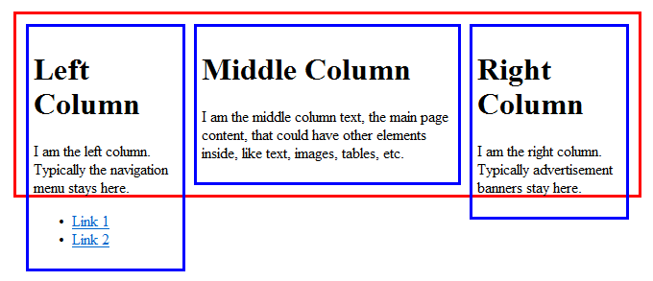
Floating DIVs
Floating DIVs are not part of their parent DIV!
Their height is the height of their content
The parent container's height can be less
Floating-left <div>
Non-floating <div>
Floating-right <div>
The container <div> has height based on its non-floating content

Slide 11
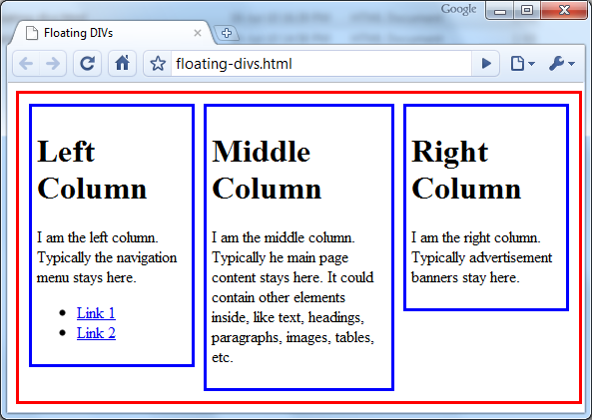

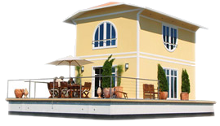
Floating DIVs
floating-divs.html
Live Demo

Slide 12
DIVs Behaving Like Tables
display:table makes DIVs behave like table:
Supported in all W3C-compliant browsers
Internet Explorer supports this since IE8
#container { display: table; }
#row { display: table-row; }
#left, #right, #middle { display: table-cell; }
<div id="container">
<div id="row">
<div id="left">Left Column</div>
<div id="middle">Middle Column</div>
<div id="right">Right Column</div>
</div>
</div>

Slide 13
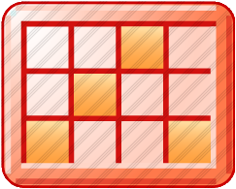
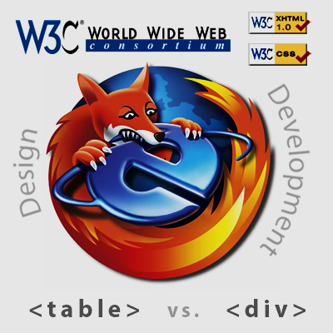
DIVs Behaving Like Tables
table-with-divs.html
Live Demo

Slide 14
Vertical Alignment of DIV
Aligning a DIV vertically is a complex task
You need three nested <div> elements:
#container { display: table; height: 400px; }
#row { display: table-row; }
#cell { display: table-cell; vertical-align: middle; }
<div id="container">
<div id="row">
<div id="cell">Vertically Centered</div>
</div>
</div>
XHTML DOCTYPE is requred, especially for IE!
<!DOCTYPE html PUBLIC "-//W3C//DTD XHTML 1.0 Transitional//EN" "http://www.w3.org/TR/xhtml1/DTD/ xhtml1-transitional.dtd">

Slide 15
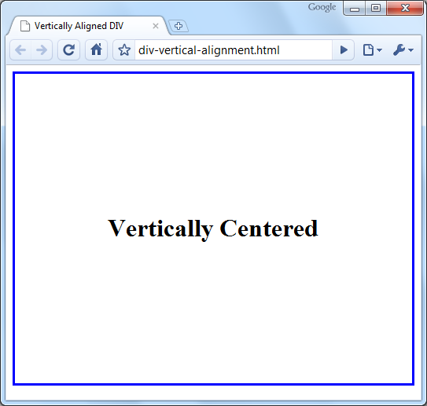
Vertical Alignment of DIVs
div-vertical-alignment.html
Live Demo

Slide 16
Distinguish between Content and Style
Separating content from presentation
The HTML content is the essential information published in the Web page, e.g. text + images
The presentation is the layout and styles used to format the content or decorate it
The content should live in the HTML
The presentation should live in the CSS
When the CSS is disabled, the site should look like an article with titles, lists and paragraphs

Slide 17
GIF, JPEG or PNG?
GIF, JPEG and PNG are the three most common image formats in the Web
JPEG is used for large images, e.g. photos
GIF and PNG support transparency
Used for bullets, icons and small images
PNG transparency not supported by old browsers
PNG files are larger than GIF
GIF supports less colors than PNG
GIF supports animation

Slide 18
Centering a Fixed-Width Site
Several ways to center the content of the site:
Placing it in <center> tag – deprecated
Using CSS text-align:center
Will affect all child nodes too
Using CSS margin:0 auto
The width of the content is fixed
The left and right margins are set to automatic
width: 900px;
margin: 20px auto;

Slide 19
Centering Site Contents – Example
<html xmlns="http://www.w3.org/1999/xhtml">
<head>
<style type="text/css">
body { background-color: #CCCCCC; }
#site-contents {
width: 940px; margin: 20px auto; }
</style>
</head>
<body>
<div id="site-contents">
<h1>Welcome to our Web site!</h1>
...
</div>
</body>
</html>

Slide 20
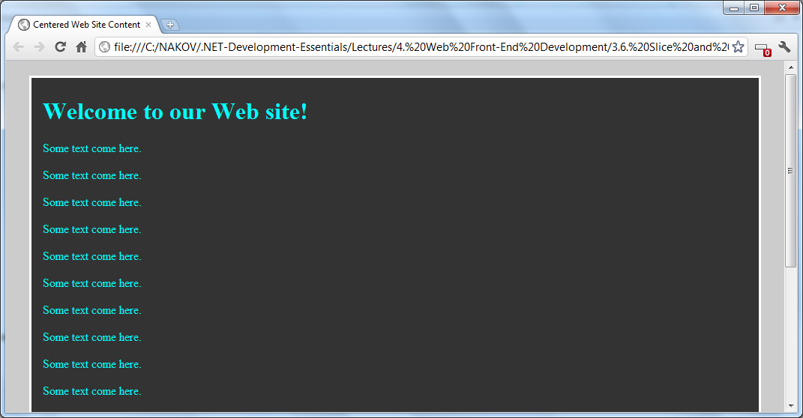

Centered Site Contents
Live Demo

Slide 21
Web Site Based on Frames
Web sites based on frames
Easy-to-develop
Works for small and simple Web sites
Considered old-fashioned, not recommended!
<frameset rows="85,*" cols="*" frameborder="no" border="0"
framespacing="0">
<frame src="header.html" scrolling="no" noresize="yes" />
<frameset cols="126,*" frameborder="no" border="0"
framespacing="0">
<frame src="left.html" name="leftFrame" scrolling="no"
noresize="yes" />
<frame src="welcome.html" name="mainFrame" />
</frameset>
</frameset>

Slide 22

Web Site with Frames
Live Demo

Slide 23
Web Site Based on Tables
Web sites based on tables
Easy to layout the page elements
Semantically incorrect, not recommended!
<table class="siteTable">
<tr class="headerRow">
<td class="logoCell">Logo</td>
<td class="headerCell">Header Text</td>
</tr>
<tr valign="top">
<td class="menuCell">Menu</td>
<td class="mainContentCell">Main Content</td>
</tr>
<tr class="footerRow"><td colspan="2">Footer</td></tr>
</table>

Slide 24
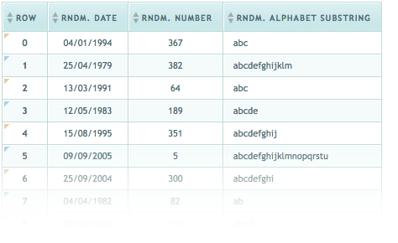
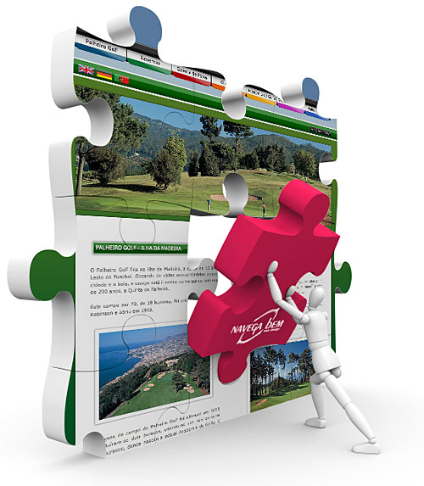
Web Site with Tables
Live Demo

Slide 25
Web Site Based on DIVs
Web sites based on DIVs
The best, semantically correct approach
Sometimes is hard to implement
<div id="header">
<div id="headerLogo">Logo</div>
<div id="headerText">Header</div>
</div>
<div id="container">
<div id="leftSidebar">Menu</div>
<div id="mainContent">Main Content</div>
</div>
<div id="footer">Footer</div>

Slide 26
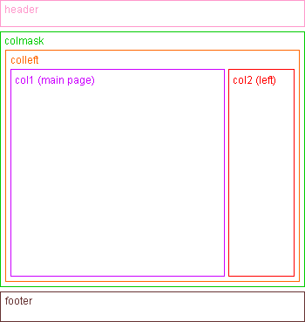
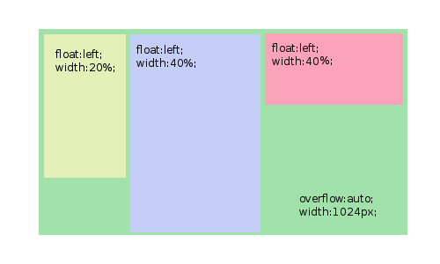

Web Site with DIVs
Live Demo

Slide 27





Creating a Web Site
Slice and Dice: Showcases

Slide 28
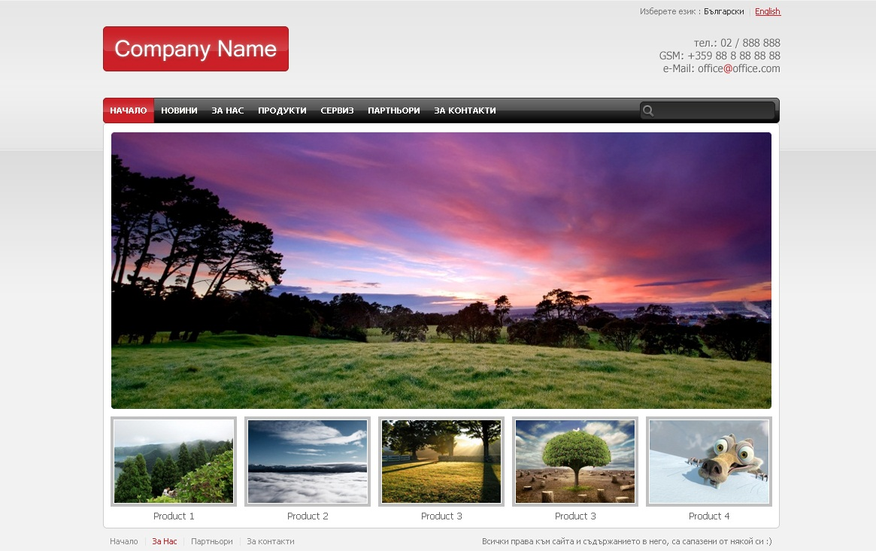
Slice and Dice Showcase
We want to slice this site into XHTML+CSS:

Slide 29
Layout and Style
What DOCTYPE?
Modern Web sites use HTML5 DOCTYPE
Fixed width or fluid width?
Fixed width will work better
Need to center the content and use some background to fill the rest of the page
Frames, tables or DIVs?
DIVs with table layout will work best
The HTML will be more semantic

Slide 30
Identify Site Sections / Pieces
First step is to determine the design parts:
Header
Menu
Content
Products
Footer

Slide 31
Identify Site Sections / Pieces (2)
Header pieces:
Language box
Logo
Contacts

Slide 32
Identify Site Sections / Pieces (3)
Menu pieces:
Menu elements
Search box

Slide 33
Identify Site Sections / Pieces (4)
Content frame pieces:
Content top image
Content
(main)
Content bottom image

Slide 34
Identify Site Sections / Pieces (5)
Products pieces:
Product image
Product title

Slide 35
Identify Site Sections / Pieces (6)
Footer pieces:
Footer item
Footer copyrights

Slide 36
Distinguish between Content and Style
The logo is content (it is clickable)
All the text should be content
The search box is style with transparent input over it
Borders, backgrounds and layout should be styles
Product images are content

Slide 37
Building the Page Layout
<div id="wrapper">
<div id="header"> ... </div>
<div id="topMenu"> ... </div>
<div class="content">
<div class="contentTop"></div>
... main content ...
<ul id="products"> ... products ... </ul>
<div class="contentBottom">
</div>
<div id="footer"> ... </div>
</div>

Slide 38
Building the Page Layout (2)
<div id="wrapper">
<div id="header">
<a href="#" class="logo"><img src="logo.gif"/></a>
<div class="contactDetails"> ... </div>
<div class="lang"> ... </div>
</div>
<div id="topMenu">
<div class="leftBg"> ... </div>
<ul> ... menu items ... </ul>
<div id="searchBox"> ... </div>
<div class="rightBg"> ... </div>
</div>
<div class="content">
<div class="contentTop"></div>
... main content ...
<ul id="products"> ... products ... </ul>
<div class="contentBottom">
</div>
<div id="footer">
<ul id="navigation"> ... </ul>
<p class="copyrights"> ... </p>
</div>
</div>

Slide 39
Define the CSS for the Layout
body { margin: 0; padding: 0; color: #666; background: #f2f2f2 url(backgr.png) repeat-x 0 0 }
#wrapper { width: 900px; margin:0 auto }
#header { position: relative; height: 130px }
.logo { position: absolute; top:35px }
.contactDetails { position: absolute; top:40px; right: 0 }
.lang { position: absolute; top:8px; right: 0 }
#topMenu { background: url(top-menu.png) repeat-x center top; overflow: hidden }
#topMenu .leftBg { background: url(top-menu-left.png) no-repeat left top }
#topMenu .rightBg { background: url(top-menu-right.png) no-repeat right top; height: 34px }
#searchBox { float:right; width: 192px; height:34px; background: transparent url(images/search.png) no-repeat }
…

Slide 40
Refine until Ready
Improve step by step each section
Divide it into subsections when needed
Define the section content
Define the CSS for each element
Test to see if the results
Fix the bugs and test again
Test for compatibility in multiple Web browsers

Slide 41



Creating a Web Site
Slice and Dice: Live Demo

Slide 42
Web Sites with XHTML and CSS (Slice and Dice)
?
?
?
?
?
Questions?
?
?
?
?
?
?

Slide 43

Exercises
Slice this Web design with XHTML and CSS. Using tables and frames is not allowed!
See the file: architecture.psd

